Slide 1
Case Study of Modern Architecture:
Smith House by Richard Meir
Rhino Modeling + Rendering with Enscape
EDI 253: DESIGN PRESENTATION AND TECHNIQUES I
Fall 2024
Maven Kavan

Slide 2
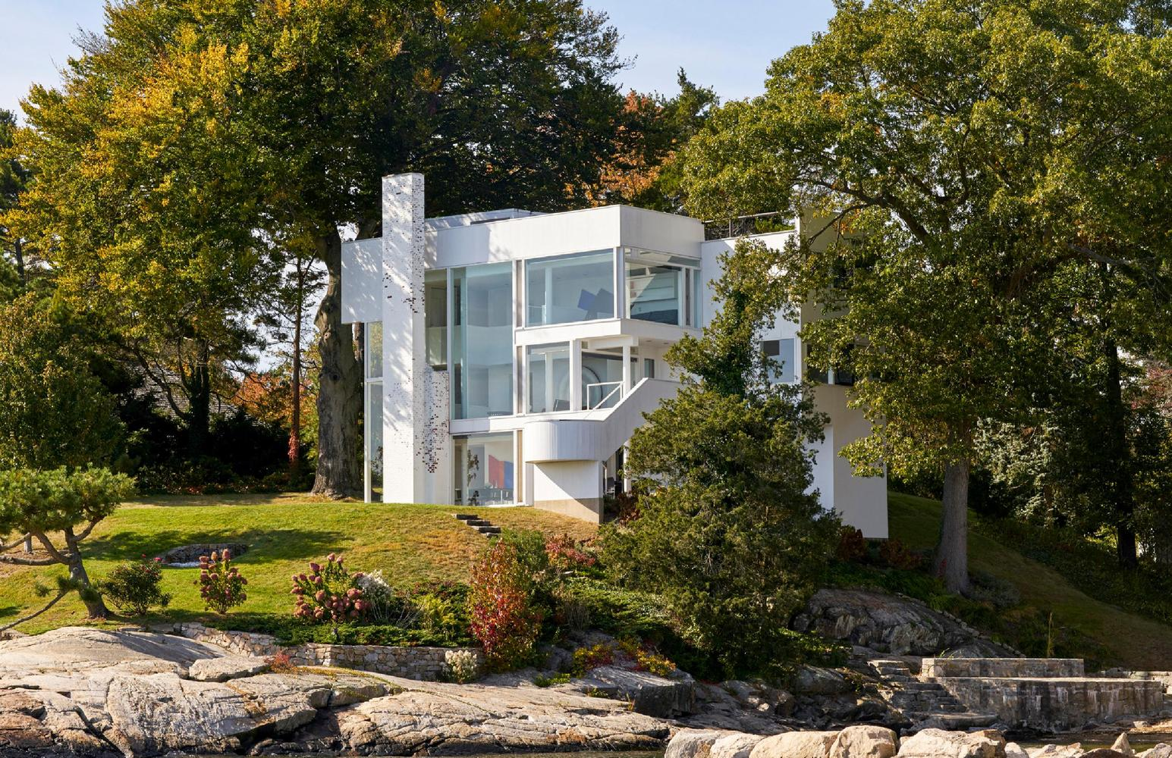
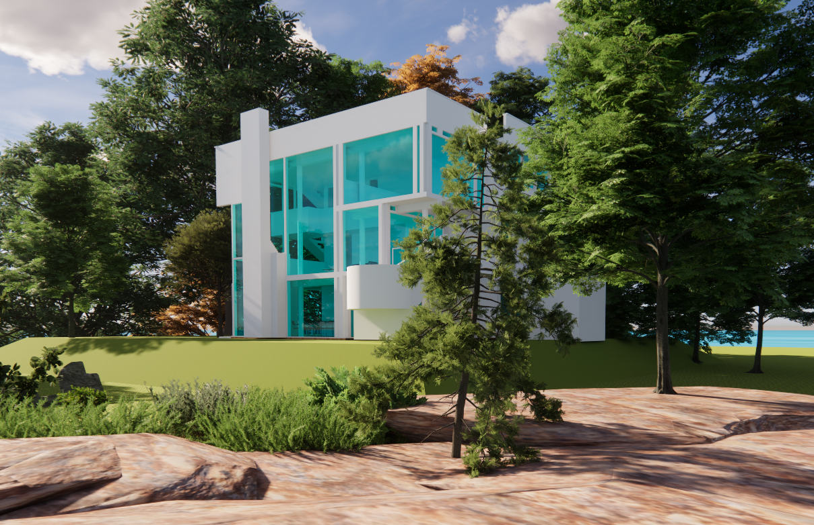
Exterior View 1
Your Rendering
2

Slide 3
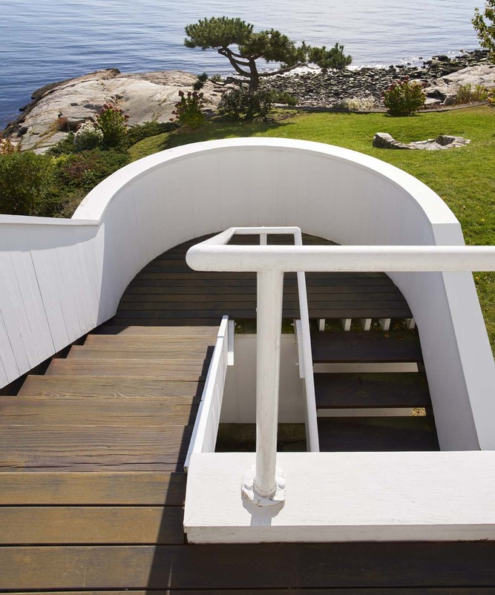
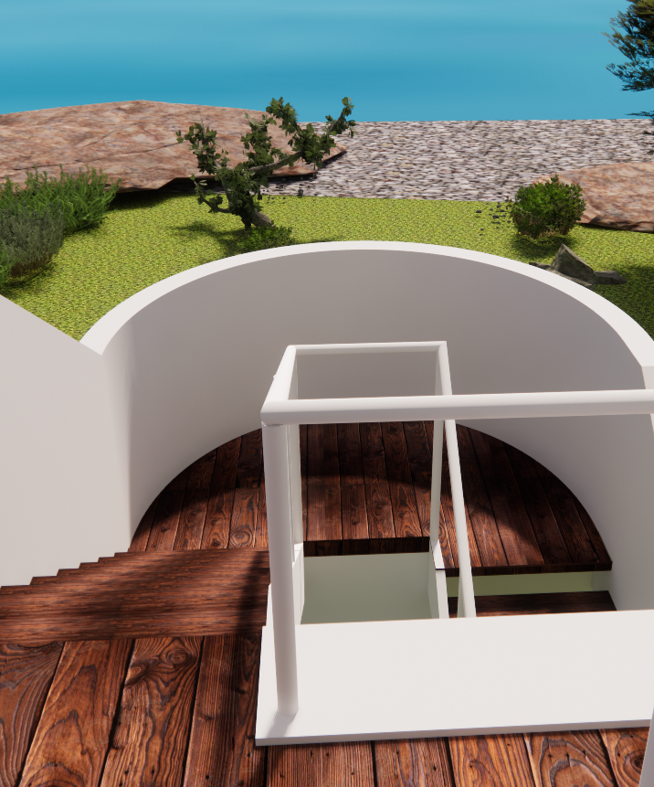
Exterior View 2
Your Rendering
3

Slide 4
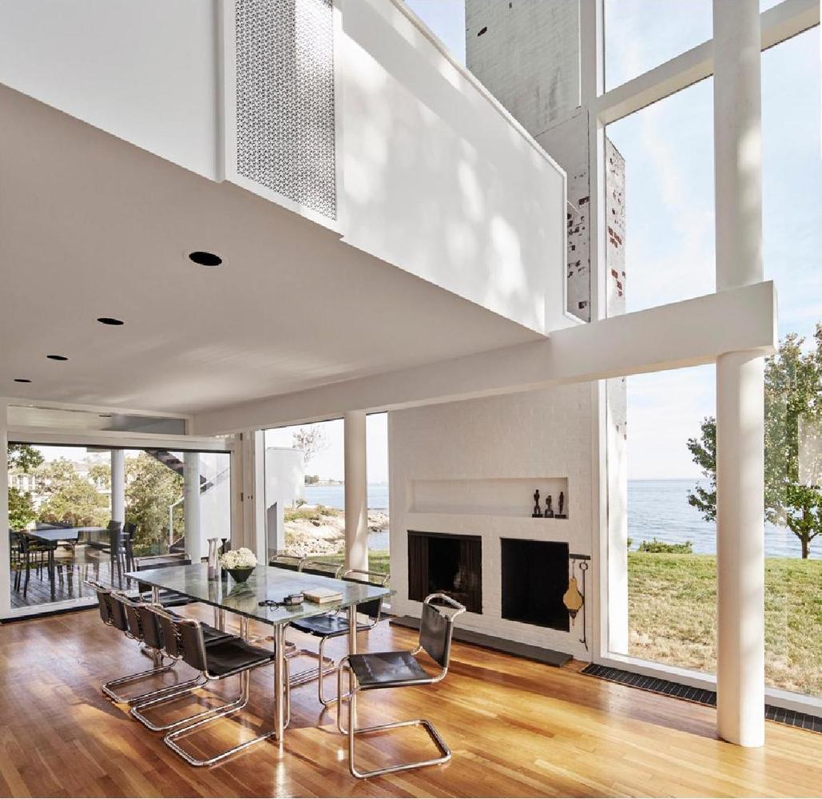
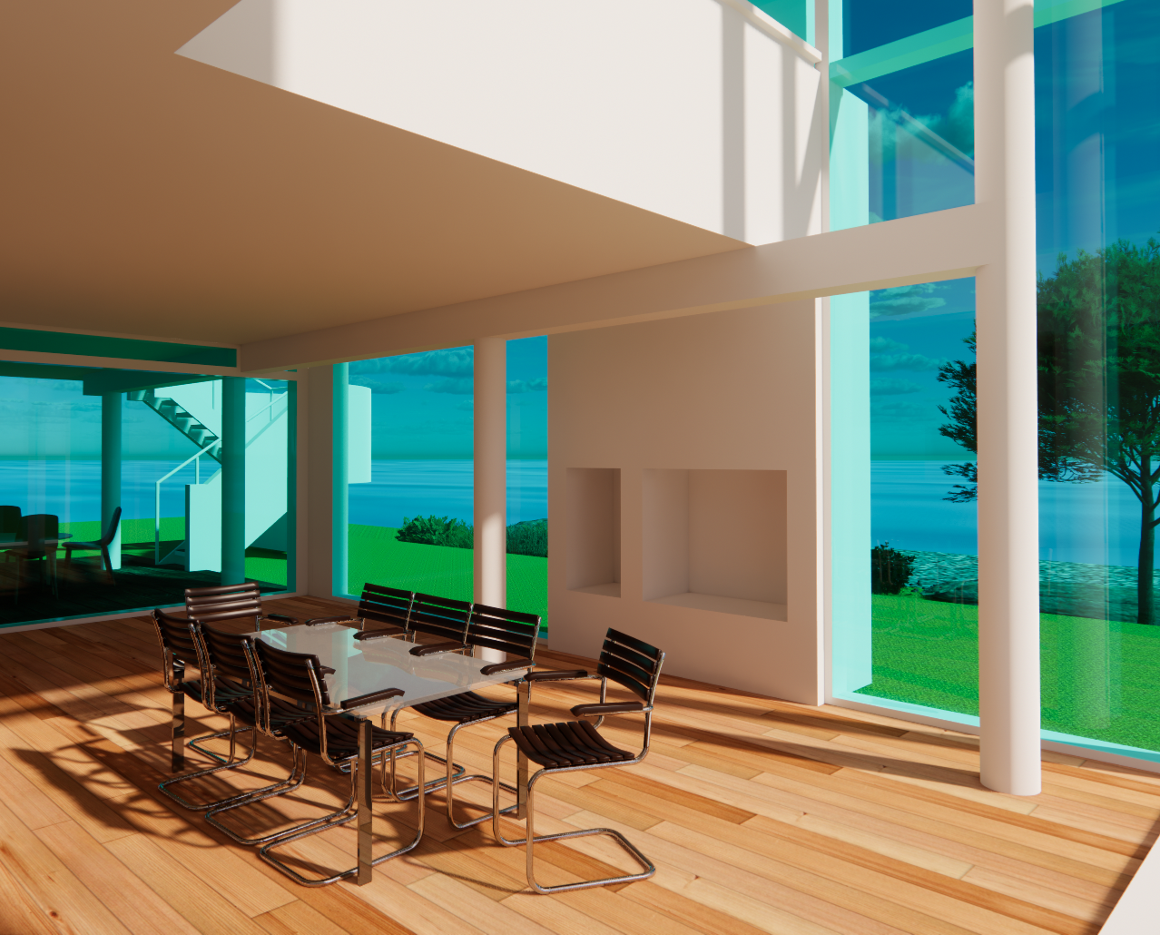
Interior View 1
Your Rendering
4

Slide 5
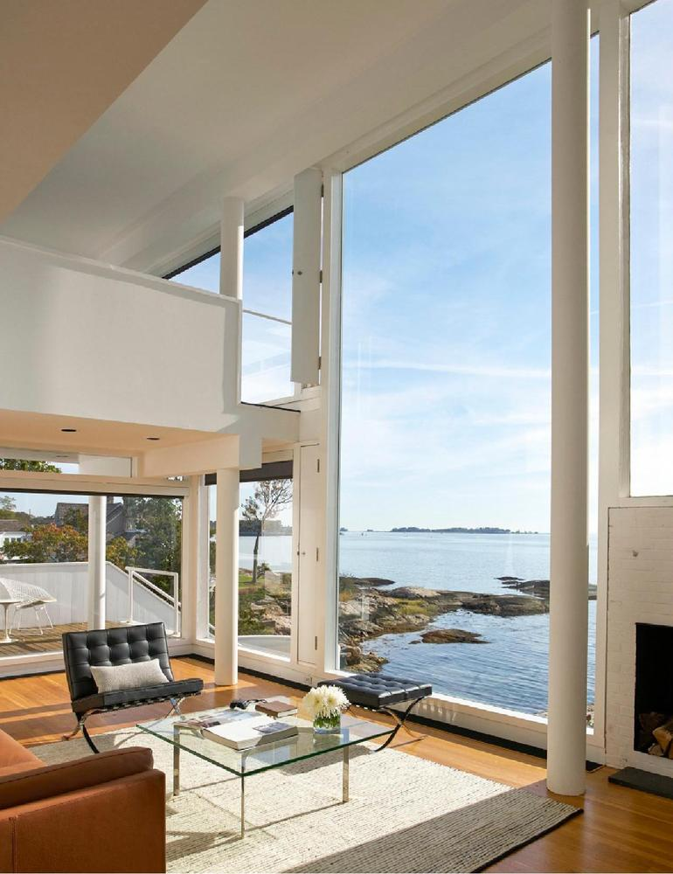
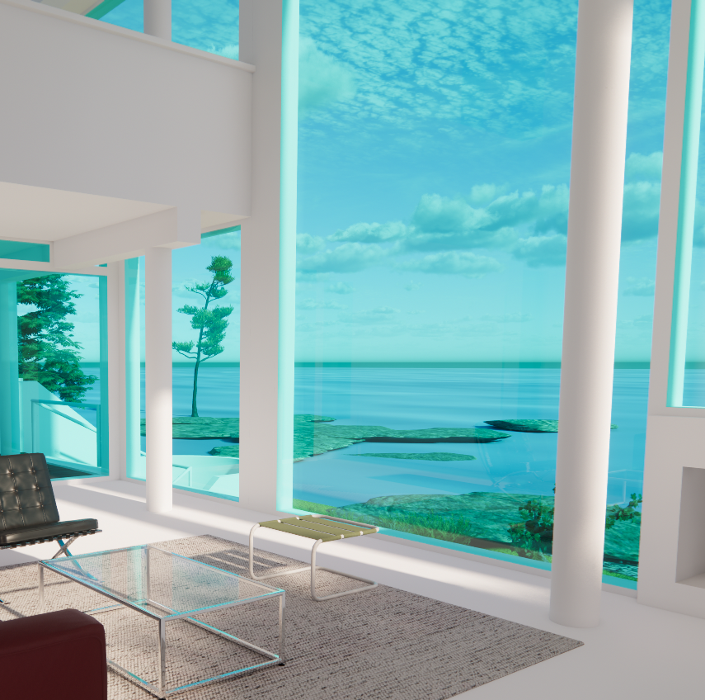
Interior View 2
Your Rendering
5

Slide 6
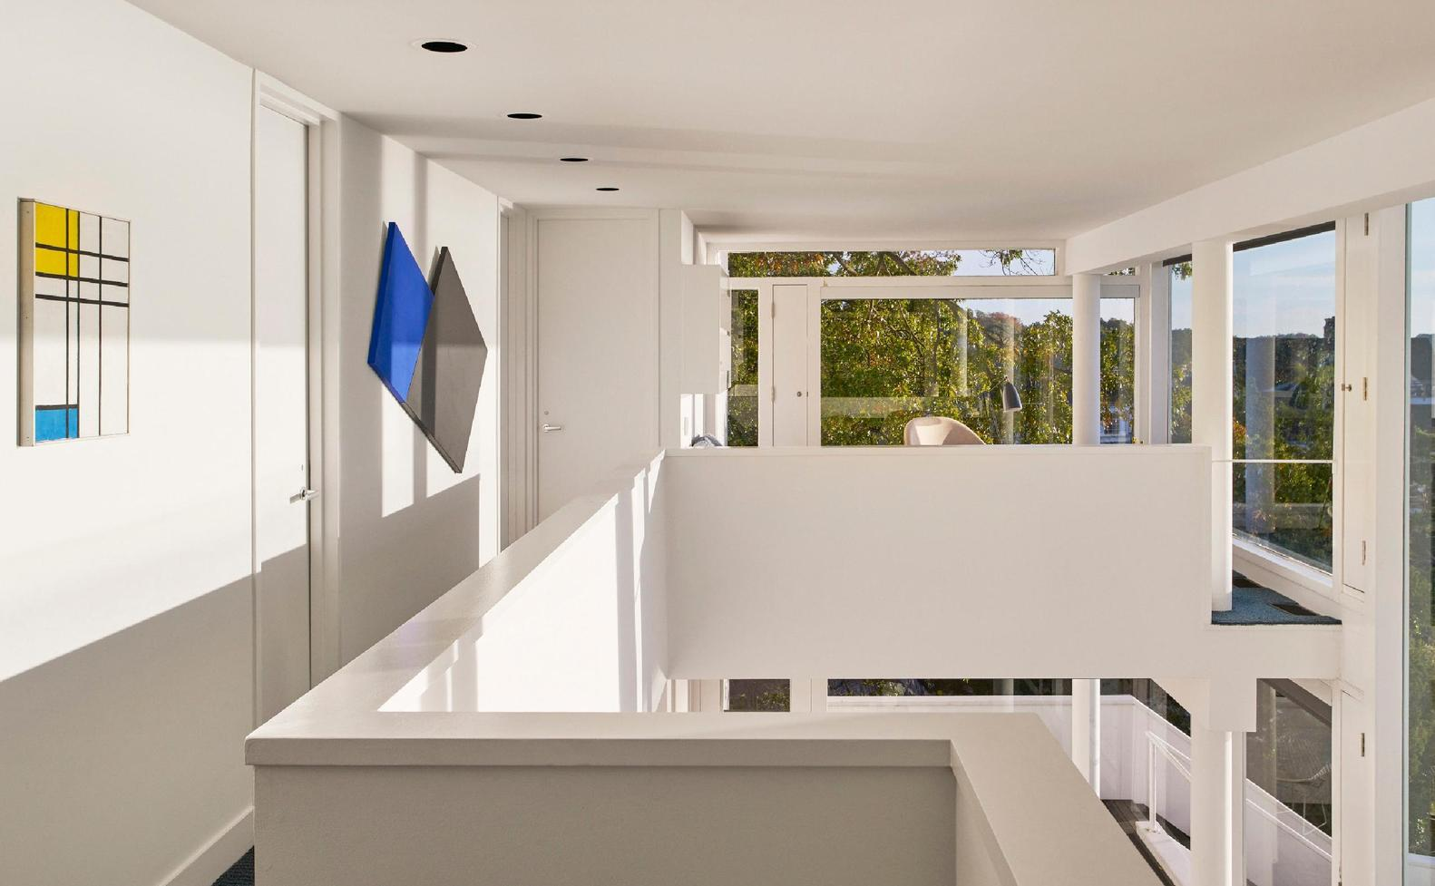
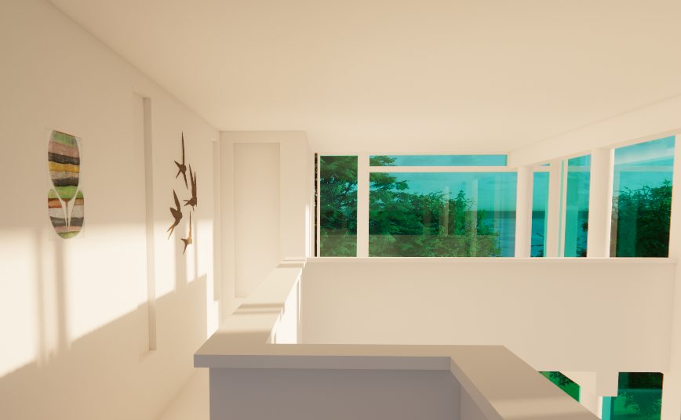
Interior View 3
Your Rendering
6

Slide 7
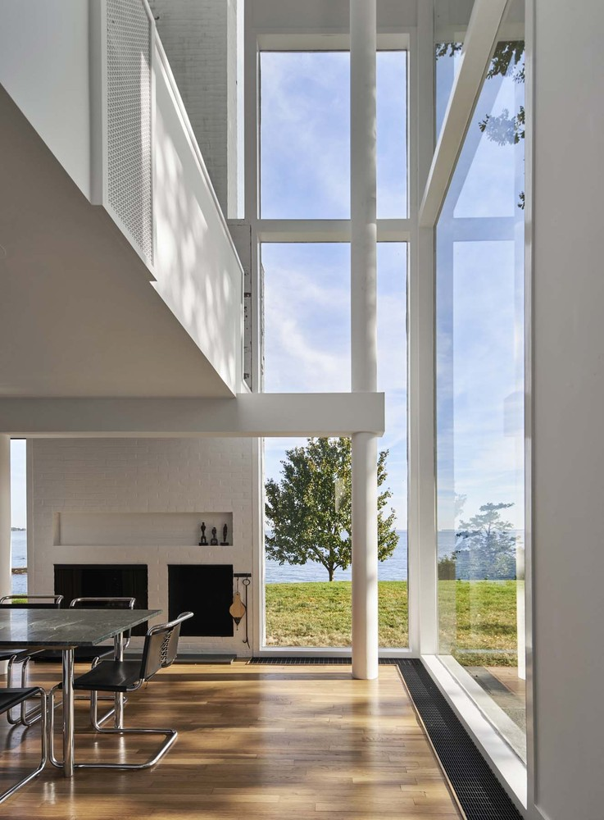
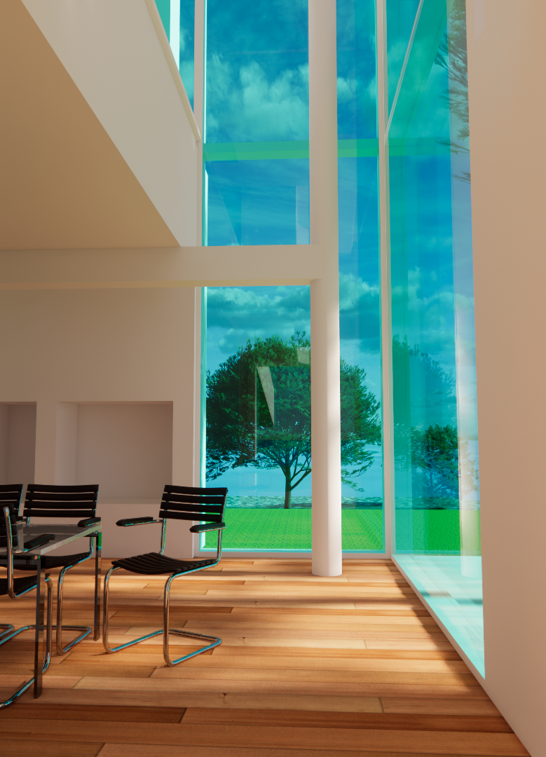
Interior View 4
Your Rendering
7

